Slide 1
User Interface BDS and HII: Technical Overview
Intel Corporation
Software and
Services Group
Copyright © 2006-2008 Intel Corporation
Notes:
For the next presentation we will be going into more detail on the Intel platform innovation framework for EFI or the “FRAMEWORK”
We will not be talking about it from marketing point of view but more from a high level technical point of view.
We will talk about the technical components the pieces that it is built out of and how it works.

Slide 2
Agenda
Boot Device Selection (BDS)
User Interface (HII)
Notes:
The Boot Device Selection (BDS)
That is where most of the policy and user interface is controlled from
Next will be the User Interface issues, localization and that is the HII or also know as the Human Interface.
Finally we will go over the Development environment.

Slide 3
Boot Device Selection Overview
Framework Boot Device Selection
Exposed
Platform
Interface
Pre Verifier
OS-Absent
App
CPU
Init
verify
Transient OS Environment
Chipset Init
Device, Bus, or Service Driver
Board Init
Transient OS Boot Loader
EFI Driver Dispatcher
Boot Manager
OS-Present
App
Intrinsic Services
Final OS Boot Loader
Final OS Environment
?
security
Security (SEC)
Pre EFI
Initialization (PEI)
Driver Execution Environment (DXE)
Boot Dev
Select
(BDS)
Transient
System Load
(TSL)
Run Time
(RT)
After Life
(AL)
Power on
[ . . Platform initialization . . ]
[ . . . . OS boot . . . . ]
Shutdown
Notes:
Let’s look back at the boot flow. BDS phase occurs right before it boots to the OS. BDS is phase that is flexible to change. You can execute pretty much any EFI application you want here. Ultimately, the OSloader will be loaded and executed to boot to the OS.

Slide 4
BDS Architecture Goals
Framework Boot Device Selection
Centralize Policy and User Interface
  Lets you customize to different look and feels
  1 board many customers
Make a central repository for platform boot policy
Allow for the ability to boot with minimal driver initialization and user interaction
Allow for implementation of setup menu
Allow for ability to store information using NVRAM variables.
See § 3 of the UEFI 2.1 Spec. (Boot Manager)
Notes:
Here are the goals of BDS.
1) Be a place where platform boot policy is determined.
2) Booting as little hassle as possible.
3) Allow a place for people to run their setup menu
None volatile variables stored in the NVRAM are used to store and determine the boot policy, dictating the drivers to load and the devices to connect, the boot device priority, etc.

Slide 5
Boot Device Selection
Framework Boot Device Selection
Policy engine controls how the system will boot
Takes control from DXE Foundation
Attempts to pass control to boot target
Arms watchdog to guard against boot failure
Iterates list of possible boot targets
  Drivers and boot targets stored in architectural environment variable lists
  May need to return to DXE Foundation if more firmware volumes are encountered
May present user interface and choices
  Setup, boot list, boot list maintenance, IHV adapter configuration, diagnostics, recovery
  OEM chooses what to expose and how to meet business requirements for the platform in given market
Notes:
Boot Device Selection (BDS) Boot manage
The BDS architectural protocol executes during the BDS phase. This protocol is discovered in the DXE phase, and is executed when two conditions are met. The first condition is that all the architectural protocols have been registered in the handle database. The second condition is the DXE Dispatcher does not have any more DXE drivers to load and execute
The good thing about BDS is that it is flexible to change. Vendors are free to develop their own implementation.
But, while the user interface and user interaction may vary, the boot policy is very rigid. This is so that the operating system installations will behave predictably from platform to platform.
Policy engine controls how the system will boot
Takes control from DXE Foundation
Attempts to pass control to boot target - OS or Pre boot
Arms watchdog to guard against boot failure
Iterates list of possible boot targets
Drivers and boot targets stored in architectural environment variable lists
May need to return to DXE Foundation if more firmware volumes are encountered
May present user interface and choices
Setup, boot list, boot list maintenance, IHV adapter configuration, diagnostics, recovery
OEM chooses what to expose and how to meet business requirements for the platform in given market

Slide 6
DXE-Dispatcher-BDS Flow
Framework Boot Device Selection
If boot fails, load next boot option
Dispatcher
Completed
Dispatching Drivers
List of Guids
OS
Loader
DXE
BDS.Entry
BDS.Entry() requires another driver to be dispatched
Notes:
BDS is a firmware policy engine that is configured by architecturally defined global NVRAM variables. It just executes the policy, it is pure and generic, and it does not let the user set the policy. Different policy will be executed according to different boot mode

Slide 7
DXE Main Calls BDS Code is located
Source code
Location in open source tree:
  EDK I \Foundation\Core\Dxe\DxeMain\DxeMain.c
  EDK II \MdeModulePkg\Core\Dxe\DxeMain\DxeMain.c
Call: DxeMain
VOID
EFIAPI
DxeMain (
IN VOID *HobStart // Pointer to the beginning of the HOB List from PEI
)
{
// DXE Main Initialize
// DXE Dispatcher
gBds->Entry (gBds); // Transfer control to the BDS Architectural Protocol
}
… … … …
… … … …

Slide 8
BDS Entry Point Code is located
Source code
Location in open source tree:
  EDK I \Sample\Platform\Generic\Dxe\UefiPlatformBds\BdsEntry.c
  EDK II \MdeModulePkg\Universal\BdsDxe\BdsEntry.c
  Call: BdsEntry()
VOID
EFIAPI
BdsEntry (
IN EFI_BDS_ARCH_PROTOCOL *This //Protocol Instance structure.
)
{
//
// Do the platform init, can be customized by OEM/IBV
PlatformBdsInit (PrivateData);
// SETUP some platform policy here
//
PlatformBdsPolicyBehavior (PrivateData, &DriverOptionList, &BootOptionList);
//
// BDS select the boot device to load OS
BdsBootDeviceSelect (); // Success means NO RETURN from caller
// Only assert here since this is the right behavior, we should never return back to DxeCore.
ASSERT (FALSE);
}
… … … …
… … … …

Slide 9
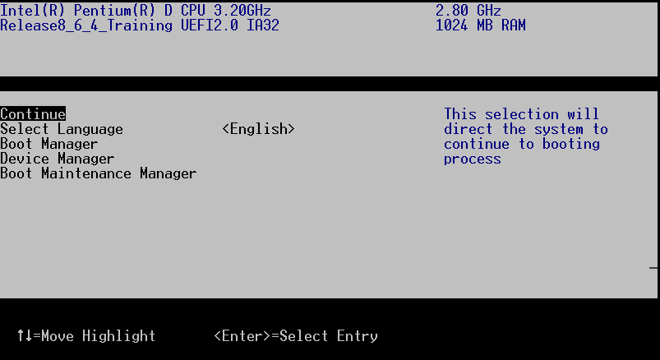
Example PlatformBdsPolicyBehavior displays Setup like menu

Slide 10
Boot Option
Framework Boot Device Selection
BDS will enumerate all possible boot devices in the system and create their boot option variables.
Current BDS will connect all devices and do this enumeration when user interrupts auto boot
  Boot Manager
  Device Manager
  Boot Maintenance Manager
Current BDS has two steps to enumerate the boot option.
  Legacy boot option for legacy boot
  EFI boot option for EFI boot
See BDS Behavior and Suggestions Document

Slide 11
BDS Policy Input
Framework Boot Device Selection
Globally Defined Variables
ConIn The device path of the default input device.
ConOut The device path of the default output device.
ErrOut The device path of the default error output device.
BDS will fill in the corresponding system table entries with the handle of the device that the variables are pointing to.
See § 3.2 of the UEFI 2.1 Spec.
Notes:
The ConIn, ConOut, and ErrOut variables each contain an EFI_DEVICE_PATH_PROTOCOL
descriptor that defines the default device to use on boot.
Changes to these values made in the preboot environment take effect immediately.
Changes to these values at OS runtime do not take effect until the next boot.
If the firmware cannot resolve the device path, it is allowed to automatically replace the values, as needed, to provide a console for the system.
If the device path starts with a USB Class device path then any input or output device that matches the
device path must be used as a console if it is supported by the firmware

Slide 12
BDS Policy Input
Framework Boot Device Selection
Globally Defined Variables
DriverOrder A list of UINT16’s that make up an ordered list of the Driver#### variable.
Driver#### A driver load option. BDS will attempt to load the driver specified. Contains an EFI_LOAD_OPTION. An example would be a PCI Root Bridge, or Serial I/O driver.
Notes:
Each Driver#### variable contains an EFI_LOAD_OPTION. Each load option variable is
appended with a unique number, for example Driver0001, Driver0002, etc.
The DriverOrder variable contains an array of UINT16’s that make up an ordered list of the
Driver#### variable. The first element in the array is the value for the first logical driver load
option, the second element is the value for the second logical driver load option, etc. The
DriverOrder list is used by the firmware’s boot manager as the default load order for UEFI
drivers that it should explicitly load

Slide 13
BDS Policy Input
Framework Boot Device Selection
Globally Defined Variables
BootOrder A list of UINT16’s that make up an ordered list of the Boot#### variable.
BootNext The Boot option for the next boot only. This option takes precedence over the Boot#### variable.
Boot#### A boot load option. BDS will attempt to load the boot driver specified. An example would be an OS loader or Setup.
Notes:
the BootOrder is not an optional variable it is the only way to set boot policy. It is not defined what happens if the user deletes BootOrder without deleting the associate variable The current BDS design assumes that BootOrder and its associated BootXXXX variables are deleted together.
Each Boot#### variable contains an EFI_LOAD_OPTION. Each Boot#### variable is the
name “Boot” appended with a unique four digit hexadecimal number. For example, Boot0001,
Boot0002, Boot0A02, etc.
The BootOrder variable contains an array of UINT16’s that make up an ordered list of the
Boot#### options. The first element in the array is the value for the first logical boot option, the
second element is the value for the second logical boot option, etc. The BootOrder order list is
used by the firmware’s boot manager as the default boot order.
The BootNext variable is a single UINT16 that defines the Boot#### option that is to be tried
first on the next boot. After the BootNext boot option is tried the normal BootOrder list is used.
To prevent loops, the boot manager deletes this variable before transferring control to the
preselected boot option

Slide 14
BDS Variable and Stack Management
Framework Boot Device Selection
NOTE: The stack is the Framework implementation example and NOT architectural.
FW Device\FW Volume\BootGuid
Boot Device
Boot
PCI Root Bridge\PCI I/O\Serial\UART\PcAnsi
ConIn Device
Boot
Boot
PCI Root Bridge\PCI I/O\Serial\UART\PcAnsi
ConOut Device
Boot
Variables
PCI Root Bridge\PCI I/O\Serial\UART\PcAnsi
StdErr Device
BDS.Entry will process the global variables. From the device paths a stack will be created on which the BDS will act upon.

Slide 15
BDS Variable and Stack Management
Framework Boot Device Selection
Dispatcher
BDS.Entry
FW Device\FW Volume\BootGuid
PCI Root Bridge\PCI I/O\Serial\UART\PcAnsi
ConnectController(&StackEntry)
PCI Root Bridge\PCI I/O\Serial\UART\PcAnsi
PCI Root Bridge\PCI I/O\Serial\UART\PcAnsi
If error called
for additional
driver
No
No
Success?
Yes
Yes
Pop driver off stack
Push driver
on stack
No
Stack empty?
Yes
Policy Action (Restart Machine/Ask Question/etc)
Notes:
BDS Architectural Protocol is a pure policy engine. It is the entry of BDS phase. It will not process any UI operation, all UI operation is in Platform BDS.
There is just one function in this protocol: BDS.Entry(). BDS.Entry() is called after the DXE Dispatcher when there are no more drivers to dispatch. If BDS fails to connect a needed driver, it will try to call dispatcher again to see if the dispatcher can find and load the missing driver. The BDS->Entry() uses a linked list which stores connect entries to load drivers, connect consoles, attempt boot options, and to store a default boot option (for now it is EFI Shell).
In general, there are 7 steps in BDS.Entry().
Initialize language and string database.
Get current boot mode. The boot mode will determine the different policy executed in step 3-7.
Build device list.
Connect devices.
Detect console devices.
Perform memory test.
Process boot options.

Slide 16
Boot Manager Policy Engine
Framework Boot Device Selection
DXE already put EFI driver images in memory
  Quiescent state: entry point operation doesn’t touch hardware
Boot devices described by EFI Device Path
  Path list of software visible hardware components supported with EFI drivers between host bus and device
Initializes console devices
  Various output devices, keyboard and mouse
  “connect” on EFI drivers specified by device path
Initializes boot devices
  Mass storage or Network
  “connect” on required EFI drivers
Proceeds to pass control to OS loader
  Iterating list of possibilities if required
Notes:
DXE already put EFI driver images in memory
Quiescent state: entry point operation doesn’t touch hardware
Boot devices described by EFI Device Path – software path to the hardware.
Path list of software visible hardware components supported with EFI drivers between host bus and device
Initializes console devices
Various output devices, keyboard and mouse
“connect” on EFI drivers specified by device path
Initializes boot devices
Mass storage or Network
“connect” on required EFI drivers
Proceeds to pass control to OS loader
Iterating list of possibilities if required

Slide 17
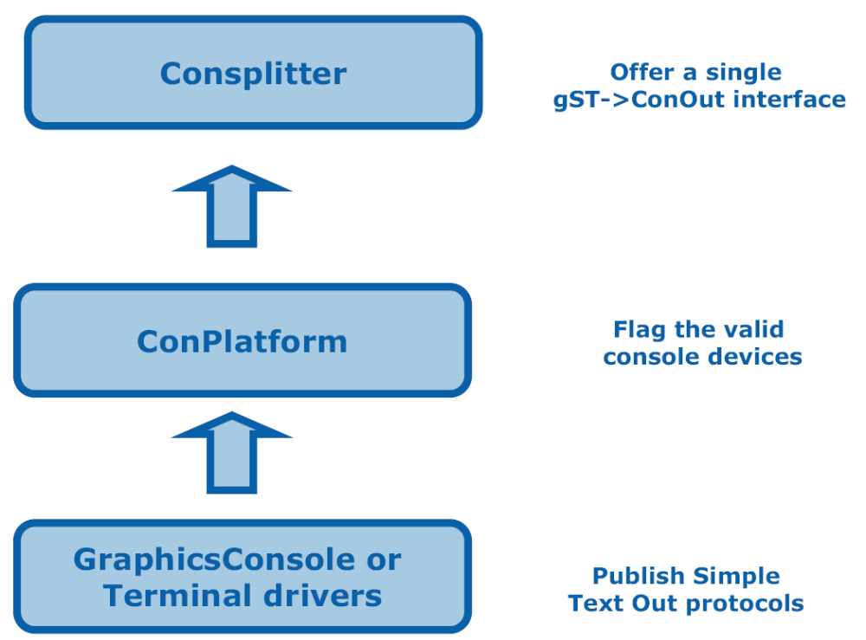
Console Device
Driver stack overview for console output case
See BDS Behavior and Suggestions Document
Notes:
The console splitter is the console device management general mechanism. It contains several drivers to enable, configure and manage all the console devices in system. The several drivers are a 3 layer driver stack
The bottom layer is the general device drivers which publish the simple text out protocols.
Examples, they are the graphic console driver (Edk\Sample\Universal\Console\GraphicsConsole\Dxe\GraphicsConsole.c) and terminal driver (Edk\Sample\Universal\Console\Terminal\Dxe\Terminal.c).
The middle layer is a platform driver, usually named ConPlatform, which bases on the platform policy to determine which simple text in device should be the ConIn device and which simple text out device should be the ConOut and ConErr device.
The ConPlatform driver will install gEfiConsoleInDeviceGuid, gEfiConsoleOutDeviceGuid or gEfiStandardErrorDeviceGuid on the selected device handles to indicate they have been selected as ConIn, ConOut or ConErr devices. Please refer to the Bearlake platform reference driver (Platform\IntelDpg\BearLake\Dxe\ConPlatform).
The top layer is a general driver (Edk\Sample\Universal\Console\ConSplitter\Dxe), named ConSplitter, which based on the gEfiConsoleInDeviceGuid, gEfiConsoleOutDeviceGuid or gEfiStandardErrorDeviceGuid to get the selected console devices. The consplitter driver will consume the simple text in or simple text out protocols on the selected console devices to offer a single interface (i.e. gST->ConIn and gST->ConOut) for high level caller.

Slide 18
BDS Summary
Framework Boot Device Selection
Allow for the ability to boot with minimal driver initialization and user interaction
Enable setup across different vendors components
Enable launch of pre-OS value added features
Centralize Policy and User Interface
  Lets OEM customize to different look and feels
  1 board many customers
Notes:
Key reason for the development of BDS – to create a centralized repository for platform policy.
This creates one location or driver that stores this information to allow easy change
Many times you will need to customize the look and feel for a particular vendor and we wanted this to be easy.

Slide 19
Demo
Handle Demo
Notes:
Introduce the demo machine 865 Intel chipset???
running FRAMEWORK
Introduce the EFI Shell
What is the EFI shell - out of flash - no formatted disk
{DH –b}
Drivers loaded out of flash are given a handle out of the handle data base -
DXE MAIN
Decompression
reads HOB where the FV exists
FV abstracts the binary image on disk or FLASH
Architectural Protocols or APIs
need these to build on
more APs
PCI ROOT bridge I/o
enough AP are loaded to load hardware
List keeps going
Loads ICH5
Loads the Video Driver
more and more drivers get loaded
WHY so many drivers ?
Drivers are registered but not loaded or connected
Start routine called
{DH –d “2c”}
Child devices are hanging off of the parent
Look for IDE controler
{DH –d A6}
Finds some devices

Slide 20
Agenda
Boot Device Selection (BDS)
User Interface (HII)
Notes:
For the agenda of this presentation we are going to talk about some back ground from the technical point of view of the design approach
Pre-EFI Initialization (PEI)
that is the execute from ROM phase that initializes memory
The Driver eXecution Environment (DXE)
That is where most of the work of the BIOS Gets done
The Boot Device Selection (BDS)
That is where most of the policy and user interface is controlled from
Next is the Backward Compatibility( CSM) for the legacy 16 bit BIOS and that is the compatibility support module or the CSM
We are going to talk about that we have this modularity so how do we find things in flash. This will include the strategies that were used for flash lay out for code and data. Called Firmware Volumes
Next will be the User Interface issues, localization and that is the HII or also know as the Human Interface.
Finally we will go over the Development environment.

Slide 21
Human Interface Overview
Framework Human Interface
Handles platform setup and application menus
Provides architecture for Device Driver setup code
Addresses issues with strings, fonts, and input devices for different languages
Separates rendering of data from the actual data – similar to Web model
Dynamic database to store components (strings, fonts, forms)
HI architecture does not dictate look and feel
Notes:
The goal of HII is provide a common database that people can build to support Human interface. This presents a way to build platform setup menu. It allows for a standard way to address issues with strings, fonts, and languages that can be used throughout Framework.
It even provides a form that provides the structure from which we can build a menu. People don’t have to write drivers for every device setup. We want a common internal interface to implement these setup menus rather than have each driver carry it’s own setup. Space is limited in firmware.*
This HII is a set of
protocols that allow a UEFI driver to provide the ability to register user interface and configuration
content with the platform firmware. Unlike legacy option ROMs, the configuration of drivers and
controllers is delayed until a platform management utility chooses to use the services of these
protocols. UEFI drivers are not allowed to perform setup-like operations outside the context of these
protocols. This means that a driver is not allowed to interact with the user outside the context of this
protocol

Slide 22
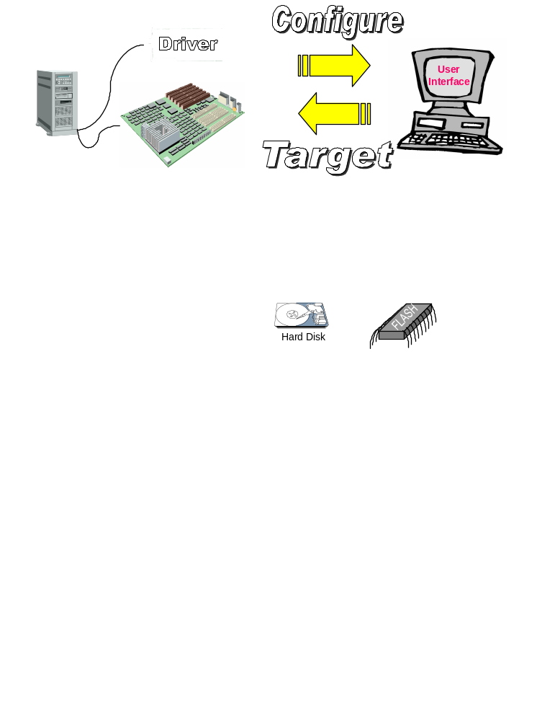
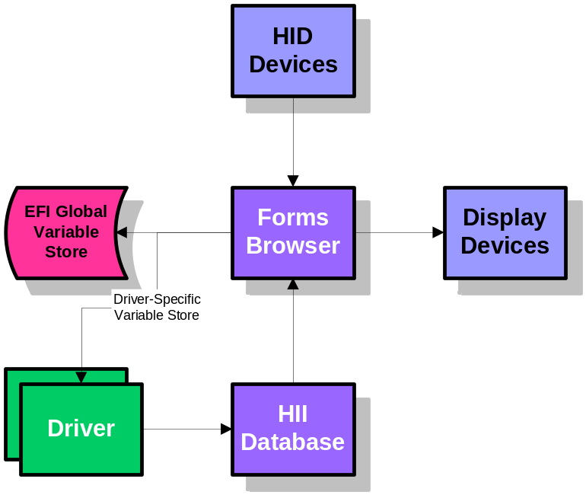
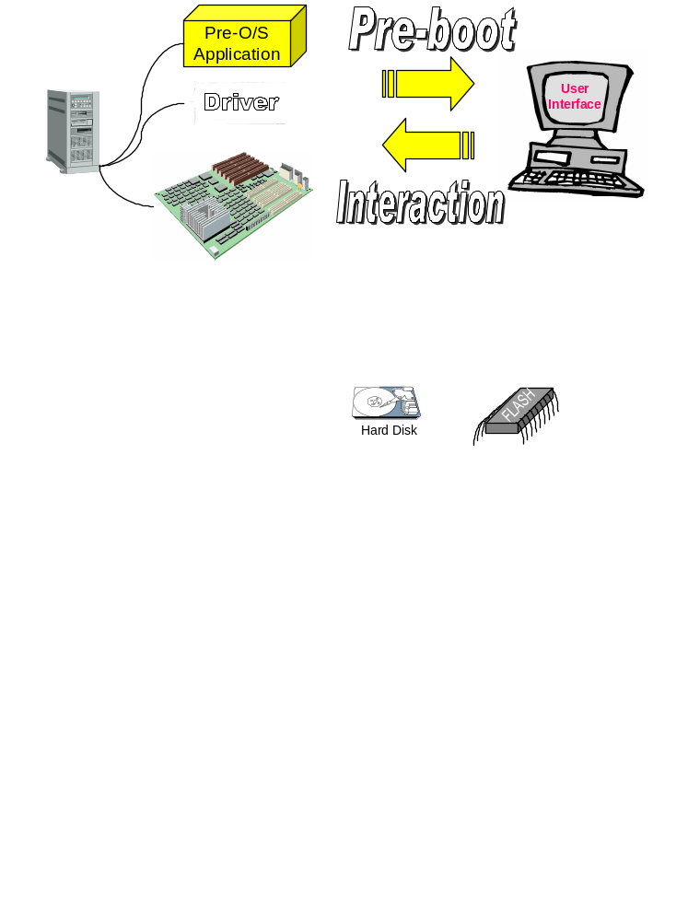
Design Discussions
See § 27.2 of the UEFI 2.1 Spec.
Notes:
The example on the right shows a basic platform configuration or “setup” model.
The drivers and applications install elements (such as fonts, strings, images and forms) into the HII Database, which acts as a central repository for the entire platform. The Forms Browser uses these elements to render the user interface on the display devices and receive information from the user via HID devices. When complete, the changes made by the user in the Forms Browser are saved, either to the EFI global variable storage—(GetVariable() and SetVariable()— or to variable storage provided by the individual drivers
TOP
Platform and Standard User Interactions
Bottom
There are various scenarios where a platform component must interact in some fashion with the user. Examples of this are when presenting a user with several choices of information (e.g. boot menu) and sending information to the display (e.g. system status, logo, etc).

Slide 23
Human Interface Components
Framework Human Interface
Strings
  Unicode representation
Fonts
  Presumption of bitmap fonts for easier localization
Keyboard
  Keyboard Mapping
Forms
  Describe user interface layout for ‘windowing’ interfaces
  An application that uses String and Font support
Package
  Self supporting data structure containing fonts, strings, and forms from a driver or set of drivers
Notes:
Strings are represented by string tokens. They are listed in a table and referenced by a token number. This results in multiple language support. Depending the language, different tables are accessed.
Fonts
Presumption of bitmap fonts for easier localization
Keyboard
Keyboard Mapping
Forms
Describe user interface layout for ‘windowing’ interfaces
An application that uses String and Font support
Package
Self supporting data structure containing fonts, strings, and forms from a driver or set of drivers

Slide 24
Strings
Framework Human Interface
Strings stored in Unicode
  Real string encodings required for e.g. VT100
  Already the text standard in EFI today
Localization happens at the string level
  Caller externs and passes in language independent string token
  String support determines actual string from token and selected language
  Usage Model:
    A string library supporting translations
      Reduces translation costs and delays
    Tools to extract strings depending on use by driver
    Analysis of strings used to extract fonts

Slide 25
Token to String Mapping
Framework Human Interface
Request: Print string with token 37
Currently selected language is as in UEFI 2.X. This is used to select between language data structures. (The structures indicate which language(s) they support).
The top part of the structure maps from token to string. The bottom part of the structure is the strings.
Currently Selected Language
English
Chinese
#37
I like Tacos
神奇计算机模型

Slide 26
Font Management
Framework Human Interface
One Standard Font for the Framework
  One font database accumulated during boot
Each Component Provides Its Fonts
  System provides ASCII and ISO Latin-1
  Fonts only required for characters in strings that may appear
    If the firmware will never print “tractor” in Kanji, discard the bit image
  Result is a sparse array of characters indexed by the Unicode ‘weight’
Wide and Narrow glyphs supported

Slide 27
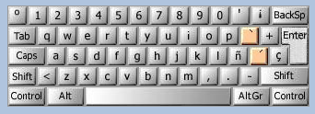
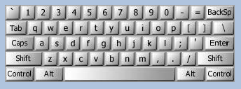
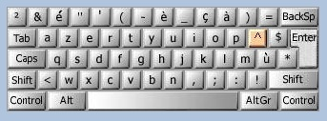
Keyboards
Framework Human Interface
Support varying keyboards
  UK and US keyboard layout are not the same. Certainly that is the case for US and Arabic, etc.
  Adding support of other modifiers (e.g. Alt-GR, Dead-keys, etc)
Keyboard Layout
  Allow for a standardized mechanism to describe a keyboard layout and add to system database.
  Allow for switching keyboard layouts.
Spanish
English
French

Slide 28
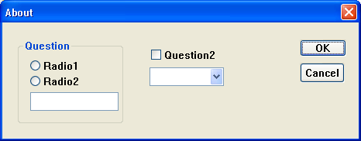
Forms
The forms are stored in the HII database, along with the strings, fonts and images
Other applications may use the information within the forms to validate configuration setting values
The Forms Browser provides a forms-based user interface which understands
  how to read the contents of the forms
  interact with the user
  save the resulting values
The Forms Browser uses forms data installed by an application or driver during initialization in the HII database.
See § 27.2.5 of the UEFI 2.1 Spec.
Notes:
How a UEFI driver or application may present a forms (or dialogs) based interface. The forms-based interface assumes that each window or screen consists of some window dressing (title & buttons) and a list of questions. These questions represent individual configuration settings for the application or driver, although several GUI controls may be used for one question

Slide 29
Framework Human Interface
Visual Forms Representation (VFR)
Language used to describe what a page layout would be in a browser as well as the op-codes and string tokens to display
Op-codes are defined for the following functions
    FormSet and Forms definitions
    Subtitle and other Text Fields
    One of type questions with corresponding options (combo)
    Checkbox fields
    Numeric Fields
    String Fields
    Password fields
    Boolean expressions in support of errors, suppression, and grayout
Notes:
VFR (Visual Forms Representation) is the development language used to create IFR (Internal Forms Representation). IFR is the compiled version of the control language. This language controls what the contents of each displayed page consists of, where the changed data gets saved, how pages are linked, and much more.
VFR source files will include a Unicode file(s) which contains the string definitions for the particular application. The Unicode file will contain both the displayed strings as well as the translations for all the supported languages for the particular application.

Slide 30
Form Example (.vfr file)
Source code
formset
guid = FORMSET_GUID,
title = STRING_TOKEN(STR_FORM_SET_TITLE),
help = STRING_TOKEN(STR_FORM_SET_TITLE_HELP),
class = 0x10,
subclass = 0,
varstore DRIVER_SAMPLE_CONFIGURATION, varid = 0x1234, name = MyIfrNVData, guid = FORMSET_GUID;
form formid = 1,
title = STRING_TOKEN(STR_FORM1_TITLE);
oneof varid = MyIfrNVData.SuppressGrayOutSomething,
prompt = STRING_TOKEN(STR_ONE_OF_PROMPT),
help = STRING_TOKEN(STR_ONE_OF_HELP),
option text = STRING_TOKEN(STR_ONE_OF_TEXT4), value = 0x0, flags = 0;
option text = STRING_TOKEN(STR_ONE_OF_TEXT5), value = 0x1, flags = 0;
option text = STRING_TOKEN(STR_ONE_OF_TEXT6), value = 0x2, flags = DEFAULT;
endoneof;

Slide 31
IFR: User Interface
Framework Human Interface
Internal Forms Representation created by VFR to IFR tool
Byte encoded operations (much smaller)
String references abstracted as tokens
Improved validation, visibility primitives
At better level of presentation control for firmware
  Tension between configuration driver and presentation driver over control of presentation format
Easy to
  Interpret for small Setup engine in desktop firmware
  Translate into XHTML or JavaScript or …
Notes:
Internal Forms Representation created by VFR to IFR tool
Byte encoded operations (much smaller)
String references abstracted as tokens
Improved validation, visibility primitives
At better level of presentation control for firmware
Tension between configuration driver and presentation driver over control of presentation format
Easy to
Interpret for small Setup engine in desktop firmware
Translate into XHTML or JavaScript or …

Slide 32

NVRAM Storage
Framework Human Interface
System Reset
BDS
DXE Driver
Human Interface Infrastructure
Database
Consists of IFR/String/Font
Which has been submitted by varying DXE Drivers
DXE Driver
DXE Driver
DXE Configuration Driver
Provides User Interface Support
Callable by a Protocol Interface
User
Changes
NVRAM
Notes:
The EFI Configuration Driver is the program that reads the contents of the HII Database and interprets the data to present it to the user. This is also the program that takes the user input and provides for a mechanism to save the changes into an NVRAM location.
There is an assumption of having some type of NVRAM available so that settings that are changed by the user are able to be saved. How one gets to the NVRAM is based on whether it is system NV storage one is accessing, or NV storage local to a specific card. Both are supported.
With the exception of setting a system password, and system date and time, settings are not posted to NV storage until the user directs the infrastructure specifically to do so. As a rule of thumb, hardware configuration changes do not take place until a system reset has occurred.

Slide 33
Driver Sample Code
UEFI 2.1 Browser example
Was constructed as a developer test to exercise the operations of the infrastructure.
  Sample “does” nothing, aside from interact with the UEFI 2.x Protocols and configuration infrastructure
  The DriverSample.c
    Consumes protocols
      EFI_HII_DATABASE_PROTOCOL, EFI_HII_STRING_PROTOCOL, EFI_HII_CONFIG_ROUTING_PROTOCOL, EFI_FORM_BROWSER2_PROTOCOL
    Produces protocol EFI_HII_CONFIGURATION_ACCESS_PROTOCOL
      ExtractConfig, RouteConfig and Callback
See § 29 of the UEFI 2.1 Spec.

Slide 34
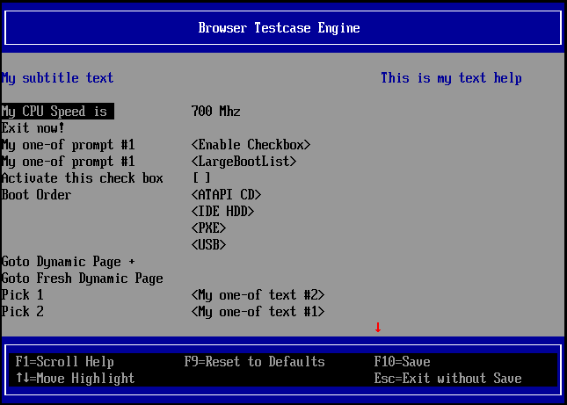
UEFI HII Driver Sample
Main Browser Menu
Device Manager
Motherboard Devices
Browser Test case Engine

Slide 35
UEFI HII Driver Sample –source code
Source code
Location in open source tree:
  EDK I Sample\Universal\UserInterface\UefiSetupBrowser\Dxe\DriverSample
  EDK II MdeModulePkg\Universal\DriverSampleDxe
// EFI_HII_CONFIGURATION_ACCESS_PROTOCOL
ExtractConfig ( //breaks apart the UNICODE request strings routing them to theappropriate drivers
RouteConfig ( //Breaks apart the UNICODE results strings and returns configuration information as specified by the request)
DriverCallback ( //called from the configuration browser to communicate activities initiated by a user.
EFI_STATUS
EFIAPI
DriverSampleInit ( //driver entry point
IN EFI_HANDLE ImageHandle,
IN EFI_SYSTEM_TABLE *SystemTable
)
{
// Initialize driver private data for produced Protocol
PrivateData->ConfigAccess.ExtractConfig = ExtractConfig;
PrivateData->ConfigAccess.RouteConfig = RouteConfig;
PrivateData->ConfigAccess.Callback = DriverCallback;
. . .
. . .
. . .
. . .
. . .

Slide 36
UEFI HII Driver Sample –source code- (continued)
Source code
// Locate Consumed protocols
Status = gBS->LocateProtocol (&gEfiHiiDatabaseProtocolGuid, NULL, &HiiDatabase);
PrivateData->HiiDatabase = HiiDatabase;
Status = gBS->LocateProtocol (&gEfiHiiStringProtocolGuid, NULL, &HiiString);
PrivateData->HiiString = HiiString;
Status = gBS->LocateProtocol (&gEfiFormBrowser2ProtocolGuid, NULL, &FormBrowser2);
PrivateData->FormBrowser2 = FormBrowser2;
Status = gBS->LocateProtocol (&gEfiHiiConfigRoutingProtocolGuid, NULL, &HiiConfigRouting);
PrivateData->HiiConfigRouting = HiiConfigRouting;
// Publish our HII data
PackageList = PreparePackageList (
2,
&mFormSetGuid,
DriverSampleStrings,
VfrBin
);
Status = HiiDatabase->NewPackageList (
HiiDatabase,
PackageList,
DriverHandle[0],
&HiiHandle[0]
);
gBS->FreePool (PackageList);
PrivateData->HiiHandle[0] = HiiHandle[0];
. . .
. . .

Slide 37
Human Interface Summary
Framework Human Interface
Localization designed in from the start
Localization is independent of display device
Multi vendor repository for Fonts
Maps setup easily into Web model
  Setup replaced with a Markup Language
  OEM can have unique look and feel
  Browser defines look and feel
  IFR maps to XML/HTML plus JavaScript

Slide 38




Q & A

Slide 39


Slide 40

Back up
Back Up

